Slide 1


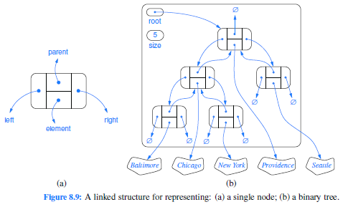
Positions and Pointers
Copy Value vs Copy Reference
Abstract Positions/Pointers
Positions in an Array
Pointer to Node
C vs Java vs Python
Building a Linked List
Walking, Dropping, and Following
Implementing Positions in Trees
Building Trees
Jeff Edmonds
York University
Lecture 2
COSC 2011

Slide 2
Quick Test
p = 5;
q = p;
q = 6;
print p;
p
5
q
5
6
For sure
5

Slide 3

Quick Test
p = big data structure;
q = p;
q.work = “HUST”;
print p.work;
p
q
I am afraid not
For sure
HUST
??
York
HUST

Slide 4
Quick Test
p = big data structure;
q = p;
p
q
Did you really want to copy all that data?
A lot of time and space to copy it all.
It is confusing to have two versions of Jeff’s data.
York
HUST

Slide 5
Quick Test
p = big data structure;
q = p;
q.work = “HUST”;
print p.work;
p
HUST
Better for p and q
not to contain
the same data
but to be
the same data.
q
“Jeff” and “Edmonds”
are two names
for the same guy.
p and q
for the same data
York
HUST

Slide 6
Quick Test
p = big data structure;
q = p;
q.work = “HUST”;
print p.work;
p
q
HUST
Pointers
How is this implemented?

Slide 7
Pointers
“pointer to data” p;
p = big data structure;
“pointer to data” q;
q = p;
p
2039
2039
p points at the data
q
Pointers
by containing the
address of the data
How is this implemented?

Slide 8
Pointers
“pointer to data” p;
p = big data structure;
“pointer to data” q;
q = p;
p
2039
2039
q
2039
The value in p
is copied to q.
Now p and q
reference
(point at)
the same data.

Slide 9
Pointers
“pointer to data” p;
p = big data structure;
“pointer to data” q;
q = p;
q.work = “HUST”;
print p.work;
p
2039
HUST
2039
q
2039
This changes the work field in the object that
q is pointing at.
This prints the work field in the object that
p is pointing at.
This happens to be the same!
Note p points at the entire data structure.
Not at any particular field.
HUST

Slide 10
Pointers
2039
0
head
element
next
2039
8715
9321
temp
element
next
8715
2039
8715
8715
element
next
x
y
9321
Name
of box
Location
of box
Value
in box
x = y
x
y
Location
of box x
Value
in box y
red = stepped on
green = go
put

Slide 11
Pointers
2039
0
head
element
next
2039
8715
9321
temp
element
next
8715
element
next
Name
of box
Location
of box
Value
in box
9321
head.next = temp.next
head
Location
of box x
Value
in box y
head.next
temp.next
red = stepped on
green = go
put

Slide 12

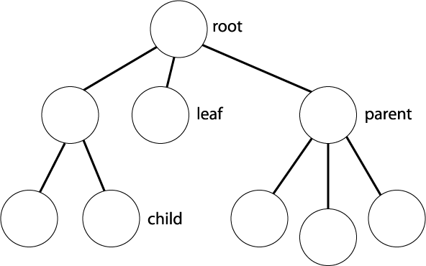
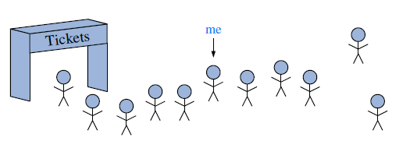



High Level Positions/Pointers
Positions: Given a data structure,
we want to have one or more current elements
that we are considering.
Conceptualizations:
Fingers in pies
Pins on maps
Little girl dancing there
Me

Slide 13
High Level Positions/Pointers
Positions: Given a data structure,
we want to have one or more current elements
that we are considering.
Moving Them:
girl₂ = tree.child(girl₂,1);
girl₂ = tree.nextSibling(girl₂);
girl₂ = tree.nextSibling(girl₂);
girl₁ = tree.root();
These are routines in tree that must be written.

Slide 14
High Level Positions/Pointers
Positions: Given a data structure,
we want to have one or more current elements
that we are considering.
Moving Them:
girl₂ = tree.child(girl₂,1)
This is a routine within the tree object.
This is the position where the girl is dancing
This is the tree object.
We must write this routine.

Slide 15
High Level Positions/Pointers
Positions: Given a data structure,
we want to have one or more current elements
that we are considering.
Moving Them:
girl₂ = tree.child(girl₂,1)
The returned child is stored in this variable.
The routine takes a parent as input
and returns it’s child.

Slide 16
High Level Positions/Pointers
Positions: Given a data structure,
we want to have one or more current elements
that we are considering.
Moving Them:
girl₂ = tree.child(girl₂,1)
This is the new value of the variable.
This is the old value of the variable.

Slide 17
High Level Positions/Pointers
Positions: Given a data structure,
we want to have one or more current elements
that we are considering.
Moving Them:
girl₂ = tree.child(girl₂,1)
Now she is located
at the child.
Girl₂ was located
at the parent.

Slide 18
High Level Positions/Pointers
Positions: Given a data structure,
we want to have one or more current elements
that we are considering.
Moving Them:
girl₁ = tree.child(girl₂,1)
girl₁
Now her friend is located
at the child.
Girl₂ is located
at the parent.

Slide 19
High Level Positions/Pointers
Positions: Given a data structure,
we want to have one or more current elements
that we are considering.
Storing Them:
A position can be stored in a variable girl₂
or in an array A[4].
A
0
1
2
3
4
5
n

Slide 20
High Level Positions/Pointers
Positions: Given a data structure,
we want to have one or more current elements
that we are considering.
Storing Them:
A position can be stored in a variable girl₂
or in an array A[4].
A position can also be stored in a data element
“pointing” at another data element.
Each element contains two fields
First storing info
Second storing the position of the next element
n

Slide 21
Pointers
Array Implantation of Positions:
Suppose the data elements are entries in an array A,
then the position of an element could be its index.
A
0
1
2
3
4
5

Slide 22
Pointers
Array Implantation of Positions:
Suppose the data elements are entries in an array A,
then the position of an element could be its index.
This entry is at position 2.
A
5
3
0
1
2
3
4
5
2
head
We can build a linked list.
head holds the position of the “first” element.
The first element holds the position of the second.
And so on.

Slide 23
Pointers
class Node {
E element;
“pointer to Node” next;
}
5
2182
element
next
This had been called a structure (or record).
It defines type called Node.
It layouts a block of memory.
It has two fields
element of type E used to hold the element’s information
next of type pointer to Node
No memory is allocated
element
next
2182
Keep track of types!
Here E is some specified type.

Slide 24
Pointers
class Node {
E element;
“pointer to Node” next;
}
In an object oriented language, this is called a class,
is instantiated by an object,
and can include data and methods (actions).

Slide 25
Pointers
class Node {
E element;
“pointer to Node” next;
}
“pointer to Node” head;
head
This defines a new variable head which is to
contain a reference/pointer to Node.
All Java variables are references/pointers
(except int i; char c; double d;)

Slide 26
Pointers
class Node {
E element;
“pointer to Node” next;
}
“pointer to Node” head;
2039
head
element
next
2039
new Node();
head =
This allocates enough memory for a Node object,
but without a variable name.
new returns the node’s address (position)
in physical memory.
Now head contains the address of the node.
We say that head “references” the object.

Slide 27
Pointers
class Node {
E element;
Node *next;
}
Node *head;
2039
head
element
next
2039
malloc( sizeof(Node) );
new Node();
head =
head->element = 5;
Notation: “pointer to Node” next;
C: Node *next;
*next is what next is pointing at.
What next is pointing at is of type Node.

Slide 28


Pointers
class Node {
E element;
Node next;
}
Node head;
head
2039
element
next
element
next
head
element
next
2039
new Node();
head =
Notation: “pointer to Node” next;
C: Node *next;
Java: Node next;
I am ok with head being a node.
But to me, this means that a Node contains a node.

Slide 29
Pointers
define Node {
element
next
}
head
2039
head
element
next
2039
= Node()
new Node()
head =
Notation: “pointer to Node” next;
C: Node *next;
Java: Node next;
Python: next
Types need not be specified.

Slide 30

Building a Linked List
1
“Get all your ducks in a row.”
First the empty list.
Then insert node 1
Then insert node 2, 3, 4, …
head
element
next
2039
2
2039
element
next
8715
3
8715
element
next
1917
4
1917
element
next
7886

Slide 31
Building a Linked List
head.element = 1
head.next = null
2039
1
head
element
next
2039
I rarely like to start coding at the beginning.
Lets start here.
This changes the element field
in the object that head is pointing at.

Slide 32
Building a Linked List
2039
1
Node temp
Node
temp =
new Node();
temp.element = 2;
head
element
next
2039
8715
2
temp
element
next
8715
How do you do this?
Make a new pointer variable temp
Make a new node.
Point temp at it.
All in one line.
Set its element to 2.

Slide 33
Building a Linked List
2039
1
Node temp = new Node();
temp.element = 2;
temp.next =
head
element
next
2039
head;
8715
2
2039
temp
element
next
8715
How do you do this?
How do you address the cell whose value is changing?
What value goes in there?
The address 2039 of node 1.
Who has that value?
That sets the pointer!

Slide 34
Building a Linked List
2039
1
Node temp = new Node();
temp.element = 2;
temp.next =
head
element
next
2039
head;
8715
2
2039
temp
element
next
8715
How do you do this?
Note temp.next = head means that
temp.next and head now point at the same object
or in Java talk,
temp.next and head now are the same object.

Slide 35
Building a Linked List
2039
1
8715
Node temp = new Node();
temp.element = 2;
temp.next =
head =
head
element
next
2039
head;
8715
2
2039
temp;
temp
element
next
8715
How do you do this?
How do you address the cell whose value is changing?
What value goes in there?
The address 8715 of node 2.
Who has that value?
That sets the pointer!

Slide 36
Building a Linked List
while( true ) {
8715
1917
1
Node temp = new Node();
temp.element = i;
temp.next =
head =
head
element
next
2039
head;
2
2039
temp;
i = i+1
}
element
next
8715
1917
3
8715
temp
element
next
1917
This forms a “linked list” containing two nodes.
Now write code to add a new node in the front.
Execute this same code again.

Slide 37
Building a Linked List
while( true ) {
1917
7886
1
Node temp = new Node();
temp.element = i;
temp.next =
head =
head
element
next
2039
head;
2
2039
temp;
i = i+1
}
element
next
8715
3
8715
element
next
1917
7886
4
1917
temp
element
next
7886
This forms a “linked list” containing three nodes.
Execute this same code again.

Slide 38
Building a Linked List
while( true ) {
7886
1
Node temp = new Node();
temp.element = i;
temp.next =
head =
head
element
next
2039
head;
2
2039
temp;
i = i+1
}
element
next
8715
3
8715
element
next
1917
4
1917
element
next
7886
This forms a “linked list” containing four nodes.
Execute this same code 100 times.

Slide 39
Building a Linked List
Node head = null;
i = 1;
while( true ) {
0
2039
Node temp = new Node();
temp.element = i;
temp.next =
head =
head
head;
1
0
2039
temp;
i = i+1
}
temp
element
next
2039
What does the empty linked list look like?
Execute the while the first time.

Slide 40
Building a Linked List
Node head = null;
i = 1;
while( true ) {
2039
Node temp = new Node();
temp.element = i;
temp.next =
head =
head
head;
1
0
temp;
i = i+1
}
element
next
2039
What does the empty linked list look like?
Execute the while the first time.
That started the list of length one as needed.

Slide 41
Building a Linked List
Node head = null;
i = 1;
while( true ) {
2039
Node temp = new Node();
temp.element = i;
temp.next =
head =
head
head;
1
0
temp;
i = i+1
}
Node head = null
i = 1
element
next
2039
while( true )
Python
Node temp = Node()
temp.element = i
temp.next =
head =
Indenting matters
head
temp
i = i+1

Slide 42
Walking a Linked List
Node walk = head;
while( ) {
walk = walk.next;
}
return;
7886
1
walk.element≠1
head
element
next
2039
2
2039
7886
element
next
8715
walk
3
8715
Always look at the current picture
before determining what next line of code will do.
element
next
1917
4
1917
element
next
7886

Slide 43
Dropping Nodes
head = new Node();
7886
1
head
element
next
2039
element
next
2
2039
7886
element
next
8715
walk
3
8715
element
next
1917
No pointers are referencing node 4.
We say it is dropped.
In C, this is a data leak.
Java does automatic
garbage collection.
4
1917
element
next
7886

Slide 44
Following Pointers
An excessively complicated example.
head
.next
.next
5
2182
2182
=
head
.next;
element
next
element
next
2039
2182
2039
head
The right hand side of the “=” specifies a memory location.
So does its left hand side.
The action is to put the value contained in the first
into the second.

Slide 45
Following Pointers
Node walk = head;
while( true) {
walk = walk.next;
}
return;
5
2182
2182
element
next
element
next
2039
2182
2039
head
walk

Slide 46
Constructors
class Node {
E element;
Node next;
}
Node head;
head =
element
next
2039
2039
head
Recall that this creates a variable head
but does not create a node.
new Node();
This creates the node.
But what if we want to execute some code
as the node is being created?

Slide 47
Constructors
class Node {
E element;
Node next;
Node(int initial){
element = initial;
}
}
Node head;
head =
5
element
next
2039
2039
head
new Node(5);
This is a constructor method for the class.
It gets executed on the new Node object as it is constructed.

Slide 48
Constructors
class Node {
E element;
Node next;
Node(){}
Node(int initial){
element = initial;
}
}
Node head;
head =
0 0
5
element
next
2039
2039
head
This constructer gets executed
if called with no inputs;
Default values are zero.
();
(5);
new Node
This is a constructor method for the class.
It gets executed on the new Node object as it is constructed.

Slide 49
High Level Positions/Pointers
Positions: Given a data structure,
we want to have one or more current elements
that we are considering.
Moving Them:
girl₂ = tree.child(girl₂,1);
girl₂ = tree.nextSibling(girl₂);
girl₂ = tree.nextSibling(girl₂);
girl₁ = tree.root();
These are routines in tree that must be written.

Slide 50
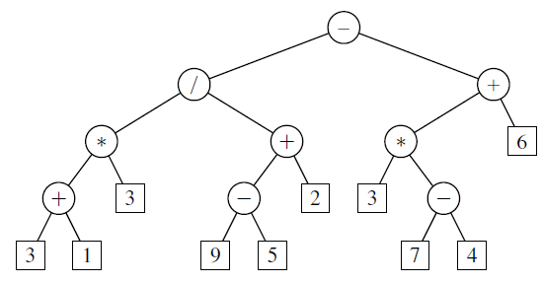
Implementations of Positions/Pointers
class LinkedBinaryTree {
tree
Defining the class binary trees.
A user will create a new one with
LinkedBinaryTree tree
The variable tree references this new object
of type LinkedBinaryTree.
Of course this object won’t start with any nodes.
= new LinkedBinaryTree();
See Goodrich Sec 8.2,8.3 Binary Trees.

Slide 51
Implementing Positions in Trees
class LinkedBinaryTree {
class Node
{
E element;
Node parent;
Node left;
Node right;
}
tree
A tree contains many nodes.
Hence, needs a node class
with fields for the element and pointers.
No memory is allocated

Slide 52
Implementing Positions in Trees
class LinkedBinaryTree {
class Node
{
E element;
Node parent;
Node left;
Node right;
}
Node root = null;
tree
private
Each tree object will have its own such variable root
that is private to it.

Slide 53
Implementing Positions in Trees
class LinkedBinaryTree {
class Node
{
E element;
Node
Node
Node
}
public
private
tree
p₁
p₂
p₃
parent;
left;
right;
The user can have many of its own fingers pointing at nodes
Node p₁, p₂, p₃;
Type Node would need to be public,
so the user can have such variables.
But does the user really need access to left & right?
This is LinkedBinaryTree’s job.

Slide 54
Implementing Positions in Trees
class LinkedBinaryTree {
class Node
implements Position{
E element;
Node parent;
Node left;
Node right;
}
public
private
tree
p₁
p₂
p₃
The user can have many of its own fingers pointing at nodes
Node p₁, p₂, p₃;
Remember that variable p_{i} is not a Node,
but is a reference/pointer/position to a Node.
We abstracted this as a Position.
Position

Slide 55
Implementing Positions in Trees
class LinkedBinaryTree {
Position root() {
return root;
}
…
tree
p₁
public
p₂
p₃
This is the tree’s
private variable
root.
This is a method within the tree
that is public to the user
and returns a value of type Positions.
At any time the user can get the position of the tree’s root.
p₁ = tree.root();

Slide 56
Implementing Positions in Trees
class LinkedBinaryTree {
Position right(Position p) {
return p.right;
}
…
tree
p₁
p₂
p₃
This is the right
field of the node
pointed to by p.
This is a method
takes a Position p as input
and returns a Positions, namely p’s right child.
At any time the user can move a position to the right child.
p₂ = tree.right(p₁);

Slide 57
Implementing Positions in Trees
class LinkedBinaryTree {
Position right(Position p) {
return p.right;
}
…
tree
p₁
2039
2039
p₂
2039
p₃
p.right contains the memory address of it’s right child.
At any time the user can move a position to the right child.
p₂ = tree.right(p₁);
This address gets copied to p₂.

Slide 58
Implementing Positions in Trees
class LinkedBinaryTree {
Position right(Position p) {
return p.right;
}
}
…
tree
p₁
2039
2039
n
p₂
2039
p₃
Node n= p;
return n.right;
Oops! If p is a Position, then
it does not know about the right field.
It must be cast as a Node.

Slide 59
Implementing Positions in Trees
class LinkedBinaryTree {
Position sibling(Position p) {
if( n.parent.right = n )
return n.parent.left;
else
return n.parent.right;
}
…
tree
p₁
n
p₂
if( n.parent != null )
Node n=p;
p₃
else
throw new IllegalArgumentException(“p is the root");
}
At any time the user can move a position to the sibling.
p₃ = tree.sibling(p₂);

Slide 60

Implementing Positions in Trees
class LinkedBinaryTree {
…
tree
p₁
p₂
p₃
At any time the user can access the element of type E
stored at a position p₂. (Here Seattle)
E e = p₂.element;
Jeff likes this, but the Java complains that element is hidden.

Slide 61
Implementing Positions in Trees
class LinkedBinaryTree {
E getElement(Position p) {
return n.element;
}
…
tree
p₁
p₂
Node n=p;
p₃
At any time the user can access the element of type E
stored at a position p₂. (Here Seattle)
E e = p₂.element;
How did we do it before?
E e = tree.getElement(p₂);
This works!
But tree does not have to be involved.

Slide 62
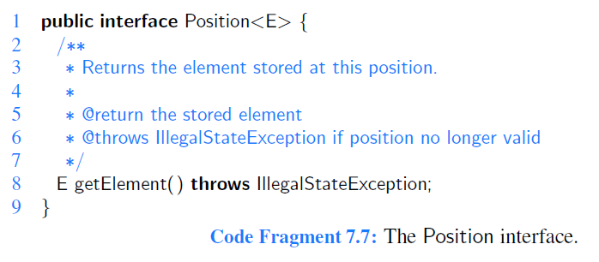
Implementing Positions in Trees
class LinkedBinaryTree {
class Node
implements Position{
E element;
E getElement() {
return element;
}
tree
p₁
p₂
p₃
…
At any time the user can access the element of type E
stored at a position p₂. (Here Seattle)
E e = p₂.element;
E e = p₂.getElement();

Slide 63
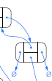

Implementing Positions in Trees
class LinkedBinaryTree {
Position addRight(Position p,E e) {
if( n.right = null )
n.right =
return
else
throw new IllegalArgumentException(
"p already has a right child");
}
…
tree
6
p₁
n
p₂
Node n=p;
size = size+1
p₃
e
new Node( , , , );
n
null,null
n.right;
?
Toronto
At any time the user can add a position/node
to the right of a position. Give this new node a string.
p₃ = tree.addRight(p₂,“Toronto”);

Slide 64
Implementing Positions in Trees
class LinkedBinaryTree {
…
tree
6
p₁
p₂
p₃
This tree is built with:
LinkedBinaryTree tree = new LinkedBinaryTree();
p₁ = tree.addRoot(“Providence”);
p₂ = tree.addLeft(p₁,“Chicago”);
p₃ = tree.addLeft(p₂,“Baltimore”);
p₃ = tree.addRight(p₂,“NewYork”);
p₂ = tree.addRight(p₁,“Seatle”);
p₃ = tree.addRight(p₂,“Toronto”);
Toronto

Slide 65
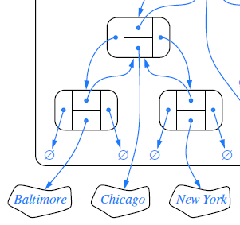

Implementing Positions in Trees
class LinkedBinaryTree {
attachLeft(Position p,
LinkedBinaryTree t₂) {
n.left = t₂.root;
t₂.root.parent = n;
…
tree
6
9
p₁
void
p₂
n
p₃
Node n=p;
size = size+t₂.size
t₂
Toronto
Suppose we have a second tree object.
tree₂
3
At any time the user can attach
it to the left of a position.
tree.attachLeft(p₃,tree₂);
(and returns nothing)
Ottawa
Montreal
Vancover

Slide 66
Implementing Positions in Trees
class LinkedBinaryTree {
attachLeft(Position p,
LinkedBinaryTree t₂) {
n.left = t₂.root;
t₂.root.parent = n;
t₂.root = null;
…
tree
9
p₁
void
p₂
p₃
Node n=p;
size = size+t₂.size
Toronto
t₂.size = 0;
Note tree and tree₂ now share nodes.
This is not a problem
if this is what you want.
Or we could make physical copies of
the nodes in tree₂ to put into tree.
Or we could disconnect tree₂.
tree₂
3
3
0
Ottawa
Montreal
Vancover

Slide 67
Implementing Positions in Trees
class LinkedBinaryTree {
attachLeft(Position p,
LinkedBinaryTree t₂) {
if( n.left = null )
n.left = t₂.root;
t₂.root.parent = n;
t₂.root = null; t₂.size = 0;
else
throw new IllegalArgumentException(
"p already has a left child");
}
…
tree
9
p₁
void
p₂
p₃
Node n=p;
Toronto
tree₂
3
0
Ottawa
Montreal
Vancover

Slide 68
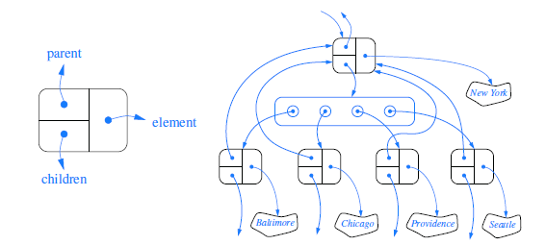
Implementing Positions in Trees
class LinkedTree {
tree
Defining the class of trees where
nodes can have many children.
We use the data structure Set or List
to store the Positions of a node’s
children.

Slide 69
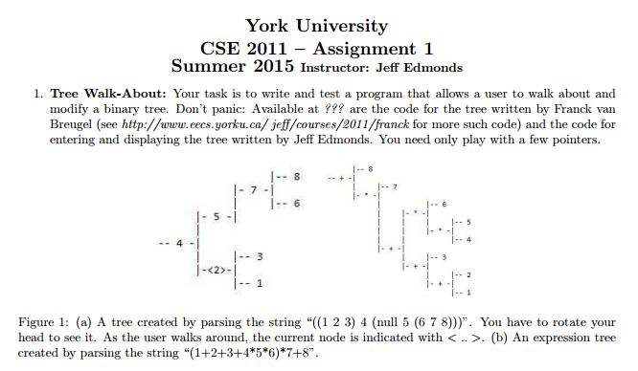
End
Positions and Pointers
Start doing the assignment NOW!

Slide 72
Implementations of Positions/Pointers
Lets do it in C first (Sorry it is better).
Objects/Structure:
struct Node {
E element;
Node *next;
};
element
next
In C this is called a structure (or record).
It defines type called Node.
It layouts a block of memory.
It has two fields
element of type E used to hold the element’s information
next of type pointer to Node
No memory is allocated
Here E is some specified type.
Keep track of types!

Slide 73
Implementations of Positions/Pointers
Objects/Structure:
Lets do it in C first (Sorry it is better).
struct Node {
E element;
Node *next;
};
Node head;
element
next
head
This allocates memory for variable head of type Node.
Useful but we won’t do it. Can’t do it in Java!
Keep track of types!

Slide 74
Implementations of Positions/Pointers
Positions/Pointers
Lets do it in C first (Sorry it is better).
struct Node {
E element;
Node *next;
};
Node *head;
head
This allocates memory for variable head.
It holds a position or a pointer.
*head denotes what it is pointing at.
Node *head states that
what head is pointing at is of type Node.
i.e. head of type pointer to Node.
Keep track of types!

Slide 75
Implementations of Positions/Pointers
Lets do it in C first (Sorry it is better).
Positions/Pointers:
struct Node {
E element;
Node *next;
};
Node *head;
head =
element
next
2039
2039
head
malloc( sizeof(Node) );
This allocates enough memory for a Node structure,
but without a variable name.
malloc returns the node’s address (position)
in physical memory.
Now head contains the address of the node.
We say that head “points” at the structure.
Keep track of types!

Slide 76
Implementations of Positions/Pointers
Lets do it in C first (Sorry it is better).
Positions/Pointers:
struct Node {
E element;
Node *next;
};
Node *head;
head =
*head
5
element
next
2039
2039
head
malloc( sizeof(Node) );
.element
= 5;
*head denotes structure that head is pointing at.
This denotes the element field of that sturcture.
This stores a 5 (of type E) in that element field.
Keep track of types!

Slide 77
Implementations of Positions/Pointers
Lets do it in C first (Sorry it is better).
Positions/Pointers:
struct Node {
E element;
Node *next;
};
Node *head;
head =
*head
*head.next =
5
2182
element
next
element
next
2039
2182
2039
head
malloc( sizeof(Node) );
.element
= 5;
malloc( sizeof(Node) );
This allocates memory for a second structure
This gets *head.next to point at it.
This is how we build a linked list.
Keep track of types!

Slide 78
Implementations of Positions/Pointers
Lets do it in C first (Sorry it is better).
Positions/Pointers:
struct Node {
E element;
Node *next;
};
a = b;
5
2182
element
next
element
next
2039
2182
2039
head
2182
2182
a
b
The right hand side of the “=” specifies a memory location.
So does its left hand side.
The action is to put the value contained in the first
into the second.
Keep track of types!

Slide 79
Implementations of Positions/Pointers
Lets do it in C first (Sorry it is better).
Positions/Pointers:
struct Node {
E element;
Node *next;
};
5
2182
2182
element
next
element
next
2039
2182
2039
head
(* )
(* )
.next
.next
head
=
(* )
.next;
head
The right hand side of the “=” specifies a memory location.
So does its left hand side.
The action is to put the value contained in the first
into the second.
Keep track of types!

Slide 80
Implementations of Positions/Pointers
Lets do it in C first (Sorry it is better).
Positions/Pointers:
struct Node {
E element;
Node *next;
};
5
2182
2182
element
next
element
next
2039
2182
2039
head
(* )
(* )
.next
.next
head
=
(* )
.next;
head
Corresponding
Notation in Java
Simpler C notation available.
head→next→next
= head→next;
head
.next
.next
=
head
.next;

Slide 81
Implementations of Positions/Pointers
Lets do it in C first (Sorry it is better).
Positions/Pointers:
struct Node {
E element;
Node *next;
};
5
2182
2182
element
next
element
next
2039
2182
Note we
skipped talking about the object.
2039
head
(* )
(* )
.next
.next
head
=
(* )
.next;
head
Corresponding
Notation in Java
Simpler C notation available.
head
→next
→next
head
.next
.next
=
head
→next;
=
head
.next;

Slide 82
Implementations of Positions/Pointers
Lets do it in C first (Sorry it is better).
Positions/Pointers:
struct Node {
E element;
Node *next;
};
5
2182
2182
element
next
element
next
2039
2182
2039
head
(* )
(* )
.next
.next
head
C does a lot of other great
things with pointers
but lets move on.
=
(* )
.next;
head
Simpler C notation available.
head
→next
→next
=
head
→next;
Keep track of types!

Slide 83
Implementations of Positions/Pointers
Now lets redo it in Java.
Objects/Structure:
class Node {
E element;
Node next;
}
element
next
Sorry I have ignored words like
private and static.
In Java it is called a class,
is instantiated by an object,
and can include data and methods (actions).
The semicolon after a class declaration is removed.
Keep track of types!

Slide 84


Implementations of Positions/Pointers
Now lets redo it in Java.
Objects/Structure:
class Node {
E element;
Node next;
}
element
next
element
next
element
next
The key difference is that there is no *.
To me, this means that a Node contains a node.
Keep track of types!

Slide 85
Implementations of Positions/Pointers
Now lets redo it in Java.
Objects/Structure:
class Node {
E element;
Node next;
}
2182
element
next
element
next
2182
No surely they just mean that
Node contains a reference/pointer to node.
Keep track of types!

Slide 86
Implementations of Positions/Pointers
Now lets redo it in Java.
Objects/Structure:
class Node {
E element;
Node next;
}
Node head;
element
next
head
The variable head of NOT a node.
Keep track of types!

Slide 87
Implementations of Positions/Pointers
Positions/Pointers
Now lets redo it in Java.
class Node {
E element;
Node next;
}
Node head;
head
All Java variables are references/pointers
(except int i; char c; double d;)
Keep track of types!

Slide 88
Implementations of Positions/Pointers
Now lets redo it in Java.
Positions/Pointers:
class Node {
E element;
Node next;
}
Node head;
head =
5
element
next
2039
2039
head
new Node(5);
This allocates enough memory for a Node object,
but without a variable name.
new returns the node’s address (position)
in physical memory.
Now head contains the address of the node.
We say that head “references” the object.
Keep track of types!

Slide 89
Implementations of Positions/Pointers
Now lets redo it in Java.
Positions/Pointers:
class Node {
E element;
Node next;
Node(int initial){
element = initial;
}
}
Node head;
head =
5
element
next
2039
2039
head
new Node(5);
This is a constructor method for the class.
It gets executed on the new Node object as it is constructed.

Slide 90
Implementations of Positions/Pointers
Now lets redo it in Java.
Positions/Pointers:
class Node {
E element;
Node next;
Node(){}
Node(int initial){
element = initial;
}
}
Node head;
head =
0 0
5
element
next
2039
2039
head
This constructer gets executed
if called with no inputs;
Default values are zero.
();
(5);
new Node
This is a constructor method for the class.
It gets executed on the new Node object as it is constructed.

Slide 91
Implementations of Positions/Pointers
Now lets redo it in Java.
Positions/Pointers:
Node head2 = head;
head2.element = 5;
head.next = new Node(6);
5
2182
6
element
next
element
next
2039
2182
2039
2039
head
head2
This declares a second variable that is set
to point at the same Node object.

Slide 92
Implementations of Positions/Pointers
Now lets redo it in Java.
Positions/Pointers:
head
.next
.next
5
2182
2182
=
head
.next;
element
next
element
next
Note we skipped talking about the object.
2039
2182
2039
head
The right hand side of the “=” specifies a memory location.
So does its left hand side.
The action is to put the value contained in the first
into the second.

